Slide 1
Hybris Commerce Accelerator

Slide 2
Agenda
Overview
Features
The Architecture
Accelerator in Practice

Slide 3
Overview
The hybris Commerce Accelerator, is a ready-to-use Web framework that will enable you to jump-start your implementation and easily build and maintain a feature-rich omni-channel commerce solution.
The hybris Multichannel Accelerator is a ready-to-use Web framework providing a fully functional storefront
It is based on the hybris Multichannel Suite and comes with a preconfigured foundation which incorporates best-practice multichannel capabilities with integrated Web, order management and call center capabilities
Using the Multichannel Accelerator allows you to greatly reduce implementation time and cost.
The hybris Multichannel Accelerator provides a collection of template extensions that form a starting point for your new ecommerce implementation project
It is delivered completely as source code.

Slide 4
Overview
The project development team simply uses the Accelerator’s source code, modifies, adds or removes code
The Accelerator makes technical choices for you such as which MVC framework to use, how to render HTML or how to handle emails.
The Accelerator requires a specific set of extensions out of the box but does not impose any limitations on adding further extensions
The modulegen functionality allows you to quickly generate a complete set of Accelerator extensions
A flexible type system permits extensions to add additional attributes to existing types
During build, model objects are generated and compiled from the type system definition, located in the items.xml file.

Slide 5

Best practice storefronts

Slide 6
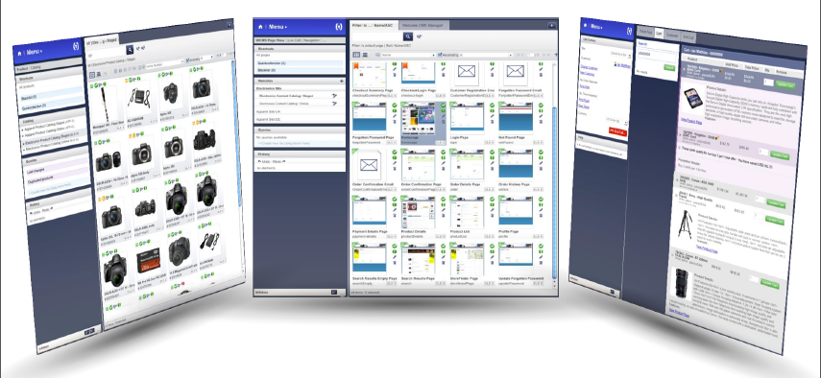
Business tool integration

Slide 7
Hybris Commerce Accelerator Features B2C
Standard eCommerce content pages with WCMS integration for desktop and mobile with device detection
Full text search capability and integration with Apache Solr
Product details with stock availability indicators
Store locator with Google Maps integration
Customer reviews and Social Network integration
Persistent shopping cart with multiple checkout strategies
Guest and Express Checkout
Address Verification and Localized Addresses
Standard fulfillment or Buy online pickup in store (BOPIS)
Customer account management and order history
Integration with payment service providers with Hosted Order Page (HOP) or Silent Order Post (SOP)
Integration with Customer Service and In Store channels
Reporting and analytics integration
Integration with hybris OMS and CIS

Slide 8
Hybris Commerce Accelerator Features B2B
B2B Organization Management
B2B Spend Control
B2B Self-Service
Customer Account Management (Order history, Quotes, Replenishment orders)
B2B Quote Negotiation
B2B Special Pricing
B2B Order Replenishment
B2B Order Approval
B2B Checkout
B2B Order Management

Slide 9
Hybris Commerce Accelerator Features Telco
Complex and complete storefront for products and services
Management of digital and physical goods package
Management of selling changing devices, content, and promotions
Bundling of products and services
Ready for implementation of initial subscription data to customer invoicing
Rule-based discounts and bundles
Possible different scenarios like upgrade of customer account, pre-paid system
Integration of Omni-channels
Automatic cross and upsells of compatible accessories

Slide 10
Hybris Commerce Accelerator Features China Accelerator
China style page templates and CMS components
Streamlined order process optimized
Payment integration with Alipay
Checkout optimized with Chinese address, delivery methods and invoice
Store finder with Baidu map and streamlined, single page design
Chinese social networks integration
*Marketplace integration with Tmall
*Checkout with Cash on Delivery payment method
*Chinese mobile storefront
*Web analytics

Slide 11
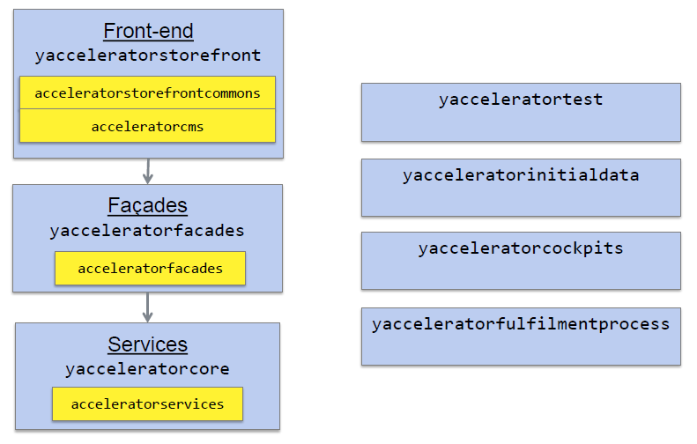
Extensions Architecture
Template and product extensions

Slide 12
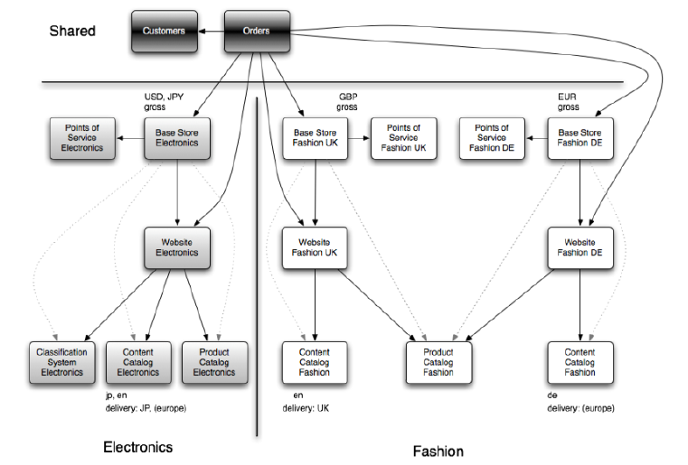
The Site Flow
Store and Site Structure in B2C Accelerator

Slide 13
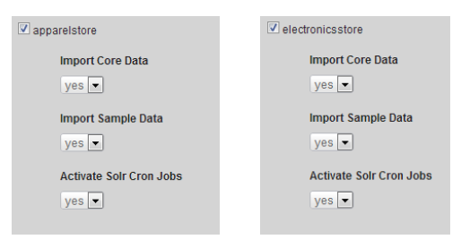
The Architecture
Electronics and Apparel Store Sampledata
Store setup extensions:
ext-data/apparelstore
ext-data/electronicsstore

Slide 14
Accelerator in Practice
Start working with the Accelerator
Run ant modulegen
Select the relevant Accelerator, name and package
Codebase is created by default under bin/custom/name
Remove template extensions from localextensions.xml
The ImpEx setup from the reference stores is a convenient point to start from to build a custom store

Slide 15
Thank You

